Slide 1

Managing a Successful Business Project
(Pearson Set)
LEARNING OUTCOME 3

Slide 2
Implement the Project Management Plan (PMP) to communicate results from the research and make conclusions from the evidence of findings
LEARNING OUTCOME 3

Slide 3





1.Analysis and evaluation of findings and data gathered
KEY LEARNING
2.Communicating results
3.Communicating skills
4.Convincing arguments

Slide 4
1.Analysis and evaluation of findings and data gathered
Digital techniques for gathering secondary and primary data:
Digital techniques can be used to gather both secondary and primary data.
Secondary Data:
Secondary data refers to data that has already been collected by someone else for a different purpose. Digital techniques make it easier to access and analyse secondary data. Here are some examples:
Online Databases:
Digital platforms provide access to a vast amount of secondary data through online databases. These databases may include research studies, reports, government data, market research, and more. Researchers can search, retrieve, and analyse relevant information from these sources.
b) Data Mining:
Digital techniques allow researchers to extract valuable insights from large datasets using data mining algorithms. These algorithms analyse patterns, trends, and relationships within the data, helping researchers discover new information or validate existing theories.
c) Social Media and Web Analytics:
Social media platforms and websites generate a significant amount of user-generated content. Digital techniques enable the collection and analysis of this data, providing insights into consumer behaviour, opinions, trends, and sentiment analysis.

Slide 5
Primary Data:
Primary data refers to data that is collected directly from the source for a specific research purpose. Digital techniques offer various tools and methods for gathering primary data. Here are some examples:
Online Surveys and Questionnaires:
Researchers can design and distribute online surveys or questionnaires to collect primary data from a large number of respondents. Digital platforms and survey tools make it easier to reach a diverse audience, track responses, and analyse the data.
b) Interviews and Focus Groups:
Digital techniques enable remote interviews and focus groups using video conferencing tools. This eliminates geographical constraints and allows researchers to collect primary data from participants located in different regions.
c) Sensor Technologies:
With the proliferation of Internet of Things (IoT) devices, researchers can gather primary data through sensors embedded in various objects. These sensors can capture and transmit data on environmental conditions, user behaviour, or other relevant factors.

Slide 6
Digital tools to analyse secondary and primary data
Tools for Analysing Secondary Data:
Secondary data refers to existing data that has been collected by someone else for a different purpose. When analysing secondary data, the following tools can be helpful:
1.Statistical Software Packages:
Statistical software packages such as SPSS (Statistical Package for the Social Sciences), SAS (Statistical Analysis System), or R are commonly used to analyse secondary data. These tools provide a wide range of statistical techniques, data manipulation capabilities, and advanced data modelling options.
2.Spreadsheet Software:
Spreadsheet software like Microsoft Excel or Google Sheets can also be used to analyse secondary data. These tools offer basic data manipulation functionalities, calculations, filtering, sorting, and basic visualizations.
3.Data Visualization Tools:
Data visualization tools like Tableau, Power BI, or Google Data Studio are valuable for creating interactive visualizations and dashboards to explore and present secondary data effectively.
4.Text Analysis Tools:
If the secondary data involves text documents or unstructured textual data, text analysis tools like NVivo, RapidMiner, or Python libraries such as NLTK (Natural Language Toolkit) can be used. These tools employ techniques like sentiment analysis, topic modelling, and text classification to extract insights from text data.

Slide 7
Tools for Analysing Primary Data:
Primary data refers to data that is collected directly from the source for a specific research purpose. When analysing primary data, the following tools can be utilized:
Statistical Software Packages:
Statistical software packages such as SPSS, SAS, or R are commonly used to analyse primary data as well. These tools offer a range of statistical techniques, data exploration capabilities, and advanced modelling options for primary data analysis.
2.Spreadsheet Software:
Similar to secondary data analysis, spreadsheet software like Microsoft Excel or Google Sheets can be used to analyse primary data. These tools provide basic data manipulation functions, calculations, and simple visualizations.
3.Survey/Questionnaire Software:
If primary data is collected through surveys or questionnaires, online survey tools like Qualtrics, SurveyMonkey, or Google Forms offer built-in analysis features. These tools provide options to generate summary statistics, cross-tabulations, and basic visualizations directly from the collected survey data.
4.Data Collection Platforms:
Data collection platforms like RED Cap (Research Electronic Data Capture) or Castor EDC offer integrated data analysis features alongside data collection. These tools provide functionalities to perform basic analyses and generate reports based on the primary data collected within the platform.

Slide 8
Evaluate the secondary and primary data
Evaluation of Secondary Data:
When evaluating secondary data, consider the following aspects:
1.Source Reliability:
Assess the credibility and trustworthiness of the source from which the secondary data was obtained. Consider the reputation, expertise, and authority of the organization or individual responsible for collecting and publishing the data.
2.Data Relevance:
Evaluate the relevance of the secondary data to your research objectives and questions. Determine if the data aligns with the variables, measurements, and context required for your analysis.
3.Data Quality:
Examine the quality of the secondary data. Look for factors such as data completeness, accuracy, consistency, and potential biases or errors. Consider the methodologies and protocols used in data collection, and be aware of any limitations associated with the data.
4.Currency and Timeliness:
Assess the currency of the secondary data. Determine if it reflects the most recent and up-to-date information available. Be cautious of outdated data that may not accurately represent the current situation or trends.
5.Comparability and Compatibility:
Consider the compatibility of the secondary data with your research needs. Assess whether the data can be compared or combined with other data sources to enhance your analysis and generate meaningful insights.

Slide 9
Evaluation of Primary Data:
When evaluating primary data, consider the following aspects:
1.Data Collection Process:
Evaluate the data collection process employed to gather the primary data. Assess factors such as sample size, sampling method, data collection instruments, and data collection protocols. Consider the rigor and validity of the data collection process and the extent to which it aligns with established research standards.
2.Data Reliability and Validity:
Examine the reliability and validity of the primary data. Assess the measures taken to ensure the accuracy, consistency, and credibility of the data. Consider factors such as inter-rater reliability, data triangulation, and data verification techniques employed during the collection process.
3.Data Representativeness:
Determine if the primary data is representative of the target population or research context. Assess the demographic characteristics, diversity, and relevant variables to ensure the data accurately reflects the intended sample or population.
4.Ethical Considerations:
Evaluate whether ethical guidelines and principles were followed during the primary data collection process. Consider if informed consent was obtained from participants, privacy and confidentiality measures were maintained, and any potential risks or harm to participants were minimized.
5.Data Quality Assurance:
Consider the steps taken to ensure data quality during the primary data collection process. Assess the use of data validation techniques, data cleaning procedures, and measures taken to address any potential biases, errors, or inconsistencies in the data.

Slide 10
Techniques for data analysis
There are various techniques for data analysis that can provide valuable insights Here are three commonly used techniques:
Coding and Categorization:
Coding involves systematically categorizing and organizing qualitative or textual data into meaningful themes or categories. This technique is commonly used in qualitative research to identify patterns, recurring themes, or key concepts within the data. It allows researchers to derive insights and draw conclusions based on the coded data. Coding can be done manually using techniques like open coding, axial coding, or selective coding, or through software tools like NVivo or ATLAS .ti .
2.Charts and Graphs:
Charts and graphs are visual representations of data that provide a clear and concise way to communicate patterns, relationships, and trends. They are widely used in quantitative data analysis and can include bar charts, line graphs, scatter plots, pie charts, histograms, and more. By visualizing data, researchers can identify patterns, compare variables, detect outliers, and present findings in a more accessible manner. Tools like Microsoft Excel, Tableau, or Python's Matplotlib and Seaborn libraries can be used to create various types of charts and graphs.

Slide 11
3.Trend Analysis:
Trend analysis involves examining data over time to identify patterns, changes, or trends. This technique is particularly useful for analysing time-series data or data collected at different time points. Trend analysis allows researchers to understand the direction and magnitude of changes, forecast future trends, and assess the effectiveness of interventions or policies. It can be done through techniques like regression analysis, moving averages, or time-series decomposition methods.

Slide 12
Techniques to create pictograms
Pictograms are visual representations that use symbols or icons to convey information or data. They are effective for simplifying complex concepts and communicating information quickly and intuitively. Here are some techniques for creating pictograms:
1.Identify the Message:
Determine the key message or information that you want to convey through the pictogram. It could be a statistic, a concept, or a process. Clarify what you want the audience to understand or take away from the visual representation.
2.Simplify and Symbolize:
Simplify the message into its essential elements and identify symbols or icons that represent those elements. Use simple and easily recognizable shapes and symbols that can be universally understood. Avoid excessive details or complexity that may confuse the audience.
3.Consistency and Clarity:
Maintain consistency in the style, size, and colour scheme of the icons used in the pictogram. Ensure that the symbols are clear, unambiguous, and easily distinguishable from one another. Use colours purposefully to enhance understanding or highlight important information.
4.Layout and Composition:
Arrange the icons in a logical and organized manner. Consider the flow and hierarchy of information. Group related symbols together and use spacing and alignment to create a visually balanced composition. Pay attention to the overall visual appeal and readability of the pictogram.

Slide 13
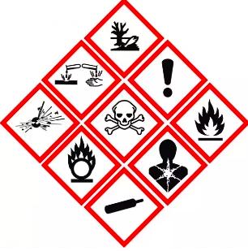
5.Testing and Feedback:
Test the pictogram with a sample audience or seek feedback from others to ensure its effectiveness in conveying the intended message. Assess if the symbols are understood correctly and if the overall visual representation is clear and engaging.
6.Technology Tools:
There are various software and online tools available that can assist in creating pictograms. Graphic design tools like Adobe Illustrator, Canva, or Microsoft PowerPoint offer icon libraries, shapes, and customization options. Alternatively, you can also create pictograms by hand-drawing or using specialized design templates.

Slide 14
Techniques to create pie charts
Creating a pie chart involves visually representing data in a circular chart divided into sectors, with each sector representing a proportion or percentage of the whole. Here are some techniques to help you create effective pie charts:
1.Collect and Organize Data:
Gather the data you want to represent in the pie chart. Ensure that the data is relevant, accurate, and complete. Organize the data into categories or groups that you want to display as different sectors in the chart.
2.Calculate Percentages:
Calculate the percentage or proportion of each data category relative to the total. To do this, divide the value of each category by the sum of all the values and multiply by 100 to get the percentage. This step is necessary to determine the size of each sector in the pie chart accurately.
3.Choose Suitable Colours:
Select colours that are visually appealing and distinct for each category in the pie chart. Use colours that are easily distinguishable from one another to avoid confusion. Consider using a colour palette that is consistent with your overall design or branding.
4.Draw the Chart:
Use a graphic design tool or software like Microsoft Excel, Google Sheets, or specialized charting software to create the pie chart. Input the data values and corresponding categories, and the software will generate the chart automatically. Alternatively, you can also draw a pie chart manually using a compass or drawing software.

Slide 15
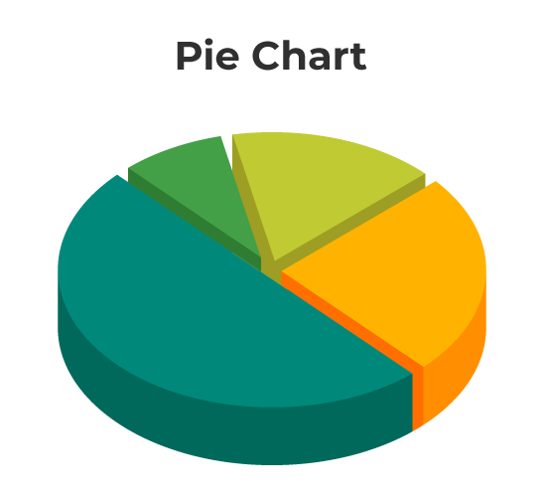
5.Label the Sectors:
Add labels to each sector of the pie chart, indicating the category or data it represents. Place the labels outside or inside each sector, ensuring they are easily readable and do not overlap. Consider using a legend if the labels become crowded or if there are too many categories to display directly on the chart.
6.Highlight Key Information:
If there is specific data or a particular category you want to highlight, you can use techniques like exploded pie charts or emphasizing certain sectors with colours or shading. These techniques draw attention to the important information in the chart.
7.Title and Additional Information:
Provide a clear and descriptive title for the pie chart, indicating the subject or theme of the data being represented. Consider including additional information, such as a source citation or a brief description of the data, if necessary.

Slide 16
Techniques to create bar charts
Creating a bar chart involves visually representing data using rectangular bars of varying lengths, with each bar representing a specific category or data point. Here are some techniques to help you create effective bar charts:
1.Collect and Organize Data:
Gather the data you want to represent in the bar chart. Ensure that the data is relevant, accurate, and complete. Organize the data into categories or groups that you want to display on the x-axis of the chart.
2.Determine the Scale:
Determine the appropriate scale for the y-axis of the bar chart. Consider the range of values in your data and choose a scale that accommodates all the values while allowing for easy visualization. Make sure the scale intervals are evenly spaced and labelled clearly.
3.Choose Suitable Colours:
Select colours that are visually appealing and distinct for each bar in the chart. Use colours that are easily distinguishable from one another to avoid confusion. Consider using a colour palette that is consistent with your overall design or branding.
4.Draw the Bars:
Use a graphic design tool or software like Microsoft Excel, Google Sheets, or specialized charting software to create the bar chart. Input the data values and corresponding categories, and the software will generate the chart automatically. Alternatively, you can also draw a bar chart manually using a ruler or drawing software.

Slide 17
5.Bar Orientation:
Decide whether you want a horizontal or vertical bar chart. In a horizontal bar chart, the bars are arranged horizontally with the y-axis representing the categories. In a vertical bar chart, the bars are arranged vertically with the x-axis representing the categories. Choose the orientation that best suits your data and makes it easier to interpret.
6.Label the Axes:
Add clear labels to the x-axis and y-axis of the bar chart, indicating the categories and corresponding values respectively. Ensure the labels are easily readable and provide units of measurement if applicable. Consider rotating the x-axis labels if they become crowded or overlap.
7.Highlight Key Information:
If there is specific data or a particular category you want to highlight, you can use techniques like colour contrast, patterned bars, or annotations to draw attention to those elements. This helps viewers focus on the important information in the chart.
8.Title and Additional Information:
Provide a descriptive title for the bar chart, indicating the subject or theme of the data being represented. Consider including additional information, such as a source citation or a brief description of the data, if necessary.

Slide 19
Techniques to create frequency curves
To create frequency curves, also known as frequency distributions or histograms, you can follow these techniques:
Collect and Organize Data:
Gather the data you want to represent in the frequency curve. Ensure that the data is relevant, accurate, and complete. Organize the data into numerical or continuous variables that you want to analyse.
2.Determine the Number of Bins:
Decide on the number of bins or intervals you want to use to group your data. This helps in organizing the data into meaningful ranges for the frequency curve. The choice of the number of bins can depend on the range and distribution of your data and the desired level of detail.
3.Calculate Frequency:
Count the number of data points falling within each bin. This represents the frequency or count of data points within that specific range. You can use spreadsheet software like Excel or statistical analysis software like R or Python to automate this process.
4.Determine Bin Width:
Calculate the width of each bin by dividing the range of your data by the number of bins. This helps in establishing consistent and evenly spaced intervals for the frequency curve. Ensure that the bin width is appropriate for capturing the variation in your data.

Slide 20
5.Plot the Curve:
Use a graphing tool or software like Excel, Google Sheets, or statistical software to create the frequency curve. On the x-axis, plot the ranges or intervals of your data (bins), and on the y-axis, plot the frequency or count of data points falling within each bin. Each bin is represented by a bar or rectangle, and the height of the bar corresponds to the frequency.
6.Label the Axes:
Add clear labels to the x-axis and y-axis of the frequency curve. Label the x-axis with the variable being analysed, and label the y-axis with the frequency or count. Include units of measurement if applicable. Ensure the labels are easily readable.
7.Title and Additional Information:
Provide a descriptive title for the frequency curve, indicating the subject or theme of the data being represented. Consider including additional information, such as a source citation or a brief description of the data, if necessary.
8.Consider Normalization:
Depending on the nature of your data, you may want to normalize the frequency curve. This involves scaling the y-axis to represent relative frequencies or proportions instead of raw counts. Normalization allows for easier comparison across different datasets.

Slide 21
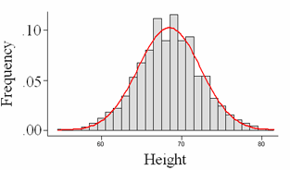

Slide 22
Techniques to create histograms
Creating histograms involves visually representing the distribution of continuous data using bars of varying heights. Here are techniques to help you create effective histograms:
Collect and Organize Data:
Gather the continuous data you want to represent in the histogram. Ensure that the data is relevant, accurate, and complete.
2.Determine the Number of Bins:
Decide on the number of bins or intervals you want to use to group your data. The choice of the number of bins can depend on the range of your data and the desired level of detail. A general guideline is to aim for around 5-20 bins.
3.Calculate Bin Width:
Calculate the width of each bin by dividing the range of your data by the number of bins. This helps in establishing consistent and evenly spaced intervals for the histogram.
4.Group Data into Bins:
Place each data point into the appropriate bin based on its value. Data points falling within each bin will contribute to the count or frequency of that bin.
5.Plot the Histogram:
Use a graphing tool or software like Excel, Google Sheets, or statistical software to create the histogram. On the x-axis, plot the ranges or intervals of your data (bins), and on the y-axis, plot the frequency or count of data points falling within each bin. Each bin is represented by a bar, and the height of the bar corresponds to the frequency.

Slide 23
6.Adjust Bar Width:
Adjust the width of each bar so that they touch each other. This creates a continuous and smooth histogram without any gaps between the bars.
7.Label the Axes:
Add clear labels to the x-axis and y-axis of the histogram. Label the x-axis with the variable being analysed or the bin ranges, and label the y-axis with the frequency or count. Include units of measurement if applicable.
8.Title and Additional Information:
Provide a descriptive title for the histogram, indicating the subject or theme of the data being represented. Consider including additional information, such as a source citation or a brief description of the data, if necessary.
9.Consider Normalization:
Depending on your needs, you may want to normalize the histogram by scaling the y-axis to represent relative frequencies or proportions instead of raw counts. Normalization allows for easier comparison across different datasets or variable scales.

Slide 24
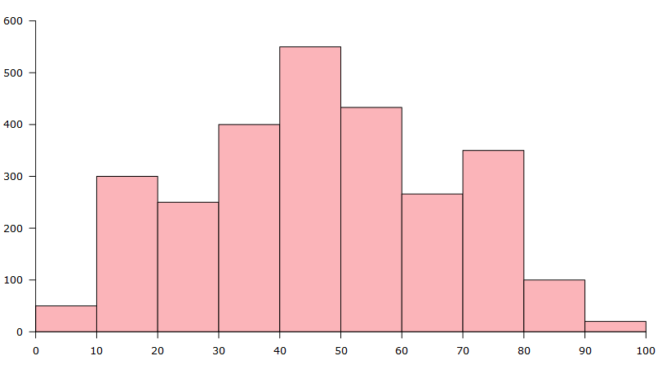

Slide 25
Techniques to create line graphs
Creating line graphs involves representing data as a series of points connected by lines, showing the relationship and trends over time or across different variables. Here are techniques to help you create effective line graphs:
Collect and Organize Data:
Gather the data you want to represent in the line graph. Ensure that the data is relevant, accurate, and complete. Organize the data into pairs or sets of variables, such as time and corresponding values.
2.Determine the Axes:
Decide which variable will be plotted on the x-axis (horizontal axis) and which variable will be plotted on the y-axis (vertical axis). The x-axis is typically used for the independent variable, such as time, while the y-axis represents the dependent variable.
3.Scale the Axes:
Determine the appropriate scales for the x-axis and y-axis. Consider the range and magnitude of your data to ensure that the graph fits well within the given space. Choose scales that allow the data to be clearly and accurately represented.
4.Plot the Data Points:
Plot each data point on the graph using the corresponding values for the x-axis and y-axis. Place a dot or marker at each data point location. If multiple data sets or variables are being represented, use different symbols or colours to distinguish them.

Slide 26
5.Connect the Data Points:
Draw lines connecting the data points in chronological or logical order. This helps to visualize trends and patterns in the data. Use straight lines to connect the points unless there is a specific reason to use curved lines.
6.Label the Axes:
Add clear labels to the x-axis and y-axis, indicating the variables being represented and their units of measurement if applicable. Make sure the labels are easily readable and appropriately positioned.
7.Title and Additional Information:
Provide a descriptive title for the line graph, indicating the subject or theme of the data being represented. Consider including additional information, such as a source citation or a brief description of the data, if necessary.
8.Highlight Key Points:
Use techniques like data markers, colour coding, or annotations to highlight specific data points or important information on the line graph. This helps draw attention to significant trends or events.
9.Consider Smoothed Lines or Trendlines:
In some cases, it may be useful to include smoothed lines or trendlines on the graph to help identify underlying trends in the data. These lines provide a visual representation of the overall pattern.

Slide 27
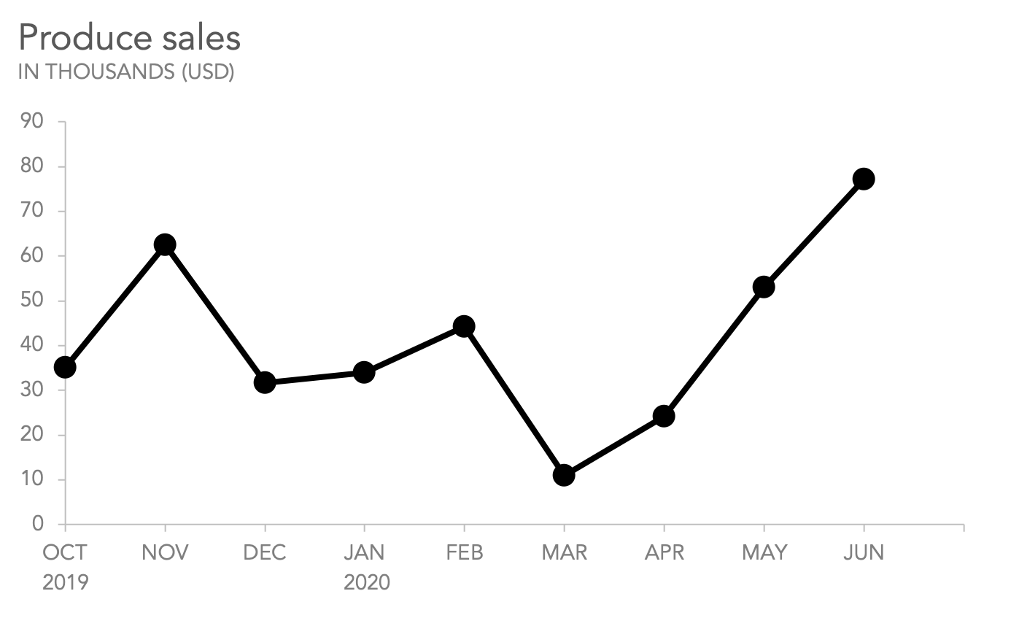

Slide 28
Techniques to create scattergrams
Creating scattergrams, also known as scatter plots or scatter charts, involves visually representing the relationship between two continuous variables through a collection of points on a graph. Here are techniques to help you create effective scattergrams:
Collect and Organize Data:
Gather the data you want to represent in the scattergram. Ensure that the data is relevant, accurate, and complete. Organize the data into pairs or sets of variables that you want to analyse.
2.Determine the Axes:
Decide which variable will be plotted on the x-axis (horizontal axis) and which variable will be plotted on the y-axis (vertical axis). The x-axis is typically used for the independent variable, while the y-axis represents the dependent variable.
3.Scale the Axes:
Determine the appropriate scales for the x-axis and y-axis. Consider the range and magnitude of your data to ensure that the graph fits well within the given space. Choose scales that allow the data to be clearly and accurately represented.
4.Plot the Data Points:
Plot each data point on the graph using the corresponding values for the x-axis and y-axis. Place a dot or marker at each data point location. Ensure that each data point is accurately positioned based on its corresponding values.

Slide 29
5.Symbolize the Data Points:
Use different symbols or colours to represent different categories or groups within the data if applicable. This helps to distinguish between different subsets of data and can provide additional insights.
6.Label the Axes:
Add clear labels to the x-axis and y-axis, indicating the variables being represented and their units of measurement if applicable. Make sure the labels are easily readable and appropriately positioned.
7.Title and Additional Information:
Provide a descriptive title for the scattergram, indicating the subject or theme of the data being represented. Consider including additional information, such as a source citation or a brief description of the data, if necessary.
8.Analyze Patterns:
Examine the patterns or trends that emerge from the scattergram. Look for relationships, correlations, or clusters of data points that may indicate a connection between the variables being plotted.
9.Consider Regression Line:
In some cases, it may be useful to include a regression line on the scattergram. A regression line helps to visualize the overall trend or relationship between the variables. It can provide insights into the direction and strength of the relationship.

Slide 30
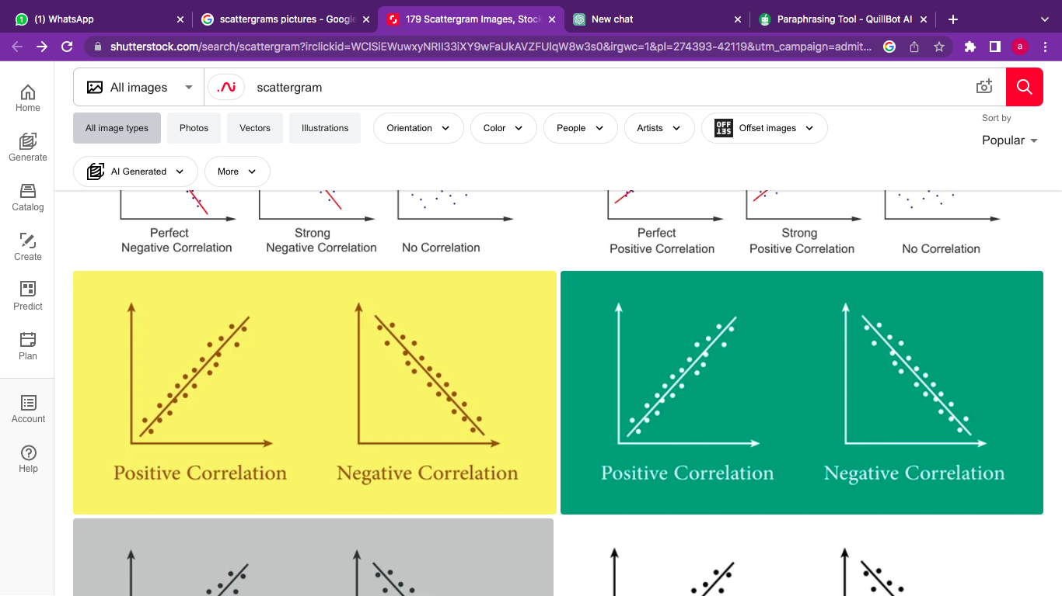

Slide 31
Use of scatter (XY) graphs and linear trend lines for forecasting
Scatter (XY) graphs and linear trend lines can be useful tools for forecasting and assessing the reliability of predictions. Here's how they can be applied in forecasting scenarios:
Data Collection:
Gather historical data that includes both the independent variable (e.g., time, input) and the dependent variable (e.g., output, performance) for which you want to make predictions. Ensure the data is accurate, reliable, and covers a sufficient time period.
2.Scatter (XY) Graph:
Create a scatter graph by plotting the data points, with the independent variable values on the x-axis and the corresponding dependent variable values on the y-axis. Each data point represents an observation in the historical data set.
3.Visual Assessment:
Analyze the scatter graph to identify any apparent trends or patterns in the data. Look for clusters or groupings of data points that suggest a relationship between the variables. This visual assessment helps in understanding the general direction of the data and any potential correlations.
4.Linear Trend Line:
Fit a linear trend line to the scatter graph to model the relationship between the variables. The trend line represents the overall direction and slope of the data points. It provides a simplified representation of the relationship and serves as a forecasting tool.

Slide 32
5.Trend Line Equation:
Determine the equation of the trend line, typically in the form of y = mx + b, where "y" represents the dependent variable, "x" represents the independent variable, "m" represents the slope of the line, and "b" represents the y-intercept. The equation allows you to calculate predicted values based on the independent variable values.
6.Forecasting:
Use the trend line equation to forecast future values of the dependent variable based on the corresponding independent variable values. Plug in the desired independent variable values into the equation to obtain the predicted values for the dependent variable. These forecasts provide an estimate of future performance or reliability based on historical trends.
7.Assessing Reliability:
Evaluate the reliability of the forecasts by comparing them with actual values as they become available. Measure the accuracy of the predictions by calculating prediction errors or calculating metrics such as mean squared error or mean absolute percentage error. This assessment allows you to gauge the effectiveness of the linear trend line for forecasting and make adjustments if necessary.
It's vital to understand that linear trend lines may not be appropriate for all data sets because they presume a linear relationship between the variables. Alternative forecasting methodologies or curve fitting techniques can be more appropriate if the relationship appears to be nonlinear. It's also important to take into account other elements that may have an impact on the accuracy of the forecasts, such as changes in the environment or the presence of outliers.

Slide 33
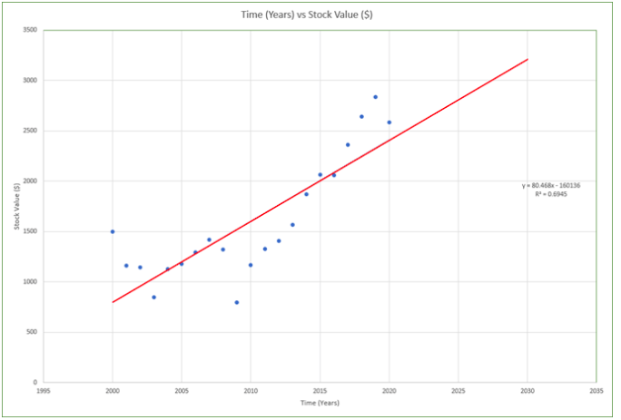

Slide 34
Techniques for creating tables to simplify and rationalise the presentation of data to aid understanding of the information within data
Creating tables is an effective way to simplify and rationalize the presentation of data, making it easier to understand and extract valuable information. Here are some techniques for creating tables that aid in the understanding of data:
Determine the Purpose:
Clearly define the purpose of the table and what information you want to convey. Identify the key variables or dimensions that need to be included in the table.
2.Organize the Data:
Structure the table to present the data in a logical and organized manner. Group related information together and arrange the variables or dimensions in a consistent order.
3.Use Clear and Concise Headings:
Provide clear and concise headings for each column and row in the table. Headings should accurately describe the content of the data and facilitate easy navigation and interpretation.
4.Highlight Key Information:
Use formatting techniques such as bolding, italics, or colour to highlight important or significant data points. This helps draw attention to key insights or trends within the table.
5.Provide Units of Measurement:
Include units of measurement for numerical data to provide context and ensure accurate interpretation. This helps readers understand the scale and magnitude of the values presented in the table.

Slide 35
6.Utilize White Space:
Use appropriate spacing and formatting to ensure the table is visually appealing and easy to read. Include sufficient white space between rows and columns to avoid clutter and improve readability.
7.Use Consistent Formatting:
Maintain consistency in formatting throughout the table. Ensure that the fonts, font sizes, and styles (e.g., bold, italics) are consistent across all elements of the table.
8.Group and Summarize Data:
When dealing with large datasets, consider grouping and summarizing the data to present a condensed view. Use subtotals, totals, or summary statistics to provide an overview of the data while preserving the key insights.
9.Add Notes or Footnotes:
Include explanatory notes or footnotes in the table to provide additional context or clarify any specific information. These notes can help readers understand the data better and avoid misinterpretation.
10.Test Readability and Clarity:
Before finalizing the table, review it for readability and clarity. Make sure the information is presented in a logical flow and that readers can easily comprehend the data without confusion.

Slide 36
Benefits of data validity
Data validity refers to the degree to which data accurately represents the real-world phenomenon or concept it is intended to measure. Ensuring data validity is crucial for drawing accurate and reliable conclusions from data analysis. Here are some benefits of data validity:
Accurate Decision-Making:
Valid data provides a solid foundation for making informed and accurate decisions. When data is valid, decision-makers can have confidence that the information they are relying on accurately reflects the reality of the situation or problem at hand.
2.Reliable Insights and Conclusions:
Valid data enables researchers and analysts to draw reliable insights and conclusions from their data analysis. Validity ensures that the findings and patterns observed are representative of the true relationships and phenomena being studied, increasing the credibility of the results.
3.Enhanced Research Quality:
Data validity is crucial in research studies. Valid data ensures that the study's measurements and observations accurately capture the intended variables and concepts, improving the overall quality and integrity of the research.
4.Trust and Credibility:
Valid data enhances the trustworthiness and credibility of the findings and the researchers or organizations presenting the data. Stakeholders, decision-makers, and the broader audience are more likely to trust and accept data that has been rigorously validated.

Slide 37
5.Effective Problem Identification:
Valid data allows for the accurate identification and understanding of problems or issues. It helps in pinpointing the root causes of problems and designing appropriate strategies or interventions to address them effectively.
6.Efficient Resource Allocation:
Valid data aids in efficient resource allocation. When data validity is ensured, resources can be allocated based on accurate information, optimizing their utilization and avoiding wasteful expenditures.
7.Improved Data Comparability:
Valid data facilitates meaningful comparisons over time, across different groups, or between different studies or datasets. Comparable data increases the ability to identify trends, patterns, and variations accurately.
8.Better Communication and Understanding:
Valid data promotes effective communication and understanding among stakeholders. When data validity is ensured, it becomes easier to convey information, present findings, and engage in data-driven discussions with confidence.
9.Increased Data Utility:
Valid data is more likely to be useful and relevant for various purposes, such as policy-making, strategic planning, or operational decision-making. It enables stakeholders to derive meaningful insights and take appropriate actions based on the data.

Slide 38
Maintaining objective mindset to provide objective results
Maintaining an objective mindset is crucial for providing objective results in any data analysis or research. Here are some key considerations to help maintain objectivity:
Define Clear Objectives:
Clearly define the objectives of the analysis or research at the outset. This helps set the foundation for maintaining objectivity throughout the process and ensures that personal biases do not influence the desired outcomes.
2.Recognize and Address Biases:
Be aware of your own biases and preconceived notions. Everyone has inherent biases, but it is important to recognize them and actively work to mitigate their impact on the analysis. Regularly reflect on your assumptions and challenge them to maintain objectivity.
3.Use Multiple Data Sources:
Relying on a single data source can introduce bias and limit the objectivity of the results. Whenever possible, gather data from multiple sources to validate findings and ensure a more comprehensive and balanced analysis.
4.Apply Rigorous Methodology:
Follow a rigorous and systematic methodology in data collection, analysis, and interpretation. This includes using appropriate statistical techniques, ensuring data quality, and documenting the entire process to enhance transparency and objectivity.

Slide 39
5.Maintain Transparency:
Clearly document the data sources, methodology, assumptions, and limitations associated with the analysis. Transparent reporting allows others to assess the validity and objectivity of the results and provides a foundation for replication and verification.
6.Peer Review and Feedback:
Seek input and feedback from peers or subject matter experts. Peer review helps identify potential biases or errors and provides an external perspective to enhance objectivity in the analysis. Be open to constructive criticism and actively consider alternative viewpoints.
7.Avoid Selective Reporting:
Present the results in a comprehensive and unbiased manner. Avoid selectively reporting only the findings that support a specific viewpoint or hypothesis. Present both positive and negative findings, as well as any limitations or uncertainties associated with the analysis.
8.Separate Opinions from Data:
Clearly differentiate between subjective opinions and objective data. Objectivity is maintained by basing conclusions and recommendations on empirical evidence and logical reasoning rather than personal beliefs or preferences.
9.Regularly Revisit Assumptions:
Throughout the analysis process, periodically reassess and challenge the assumptions made. Be open to revising initial assumptions based on emerging evidence or new insights. This helps maintain flexibility and adaptability in the analysis, allowing for objective adjustments as needed.

Slide 40
2.Communicating results
Communicating results effectively is essential to ensure that the findings and insights from your data analysis or research are understood and impactful. Here are some key considerations for communicating results:
Know Your Audience:
Understand who your audience is and tailor your communication accordingly. Consider their level of knowledge, interests, and specific information needs. Adapt your language, terminology, and level of detail to make the results accessible and relevant to your audience.
2.Clear and Concise Messaging:
Focus on conveying the key findings and insights in a clear and concise manner. Avoid jargon or technical language that may confuse or alienate your audience. Use plain language and simple explanations to ensure that the message is easily understood.
3.Use Visuals:
Utilize visual aids such as charts, graphs, tables, and infographics to present the data in a visually appealing and easily understandable format. Visuals can help simplify complex information, highlight key trends, and enhance the overall clarity of your message.
4.Storytelling Approach:
Frame your results within a compelling narrative that tells a story. Structure your communication to provide context, build suspense, and present the findings in a logical sequence. Connect the dots between the data and the real-world implications to engage your audience and make the results more memorable.

Slide 41
Types of communication methods
Communication methods can be classified into various categories based on the mode of communication and the medium used. Here are some common types of communication methods along with examples of different mediums:
Written Communication:
  Reports: Comprehensive written documents that present findings, analysis, and recommendations. Examples include research reports, project reports, or white papers.
  Emails: Written messages sent electronically to convey information, updates, or requests.
  Memos: Short written messages within an organization to communicate important information or updates.
  Letters: Formal written communication addressed to a specific individual or organization.
Verbal Communication:
  Presentations: Oral communication accompanied by visual aids, such as slides or multimedia, to deliver information or share findings with an audience.
  Meetings: In-person or virtual gatherings where information is exchanged, discussions take place, and decisions are made.
  Phone Calls: Direct conversations conducted over the telephone to share information or have discussions.
  Video Conferencing: Real-time audio and video communication conducted remotely, allowing for face-to-face interaction between participants.

Slide 42
3.Visual Communication:
  Infographics: Visual representations of data or information, combining text, icons, and images to convey complex concepts or trends quickly.
  Data Visualizations: Charts, graphs, and maps that visually represent data to highlight patterns, relationships, or comparisons.
  Dashboards: Interactive visual displays that provide real-time or summarized data to monitor key metrics or performance indicators.
  Diagrams and Flowcharts: Visual representations of processes, systems, or relationships to enhance understanding and clarity.
4.Online Communication:
  Websites: Online platforms that provide information, resources, or reports accessible to a wide audience.
  Blogs: Informal online articles or posts that share insights, experiences, or analysis on a particular topic.
  Social Media: Platforms like Twitter, LinkedIn, or Facebook that enable short-form messaging, sharing of content, and engaging with a broader audience.
  Discussion Forums: Online platforms where individuals can engage in conversations, ask questions, and share insights related to a specific topic or community.

Slide 43
5.Interactive Communication:
  Workshops or Training Sessions: Interactive sessions where participants engage in hands-on activities, discussions, and collaborative exercises to learn and share information.
  Webinars: Online seminars or presentations where participants can listen, ask questions, and engage with the presenter in real-time.
  Focus Groups: Small-group discussions led by a facilitator to gather qualitative insights, opinions, or feedback on a specific topic or product.

Slide 44
Multi-media presentation tools
PowerPoint:
Microsoft PowerPoint is one of the most widely used presentation software. It offers a range of features, including slide design, animation, multimedia integration (images, audio, video), and various templates and themes. It allows you to create professional-looking presentations with ease.
2.Prezi:
Prezi is a cloud-based presentation tool that offers a unique and dynamic approach to presentations. It uses a canvas layout rather than traditional slides, enabling users to create visually engaging presentations with zooming and panning effects. Prezi allows for non-linear storytelling and can add an interactive touch to your presentations.
3.Google Slides:
Google Slides is part of the Google Workspace suite and provides a web-based platform for creating presentations. It offers collaboration features, real-time editing, and the ability to access presentations from anywhere with an internet connection. Google Slides supports a wide range of multimedia elements and allows for easy sharing and collaboration with others.
4.Microsoft Sway:
Microsoft Sway is a web-based presentation tool that focuses on creating interactive and visually appealing presentations. It offers a variety of design templates, animations, and multimedia integration. Sway's responsive design allows presentations to adapt to different devices and screen sizes.

Slide 45
5.Adobe Spark:
Adobe Spark is a suite of creative tools that includes Spark Video, Spark Page, and Spark Post. Spark Video allows you to create engaging videos with text, images, and narration. Spark Page enables you to create web-based presentations with a scrolling layout. Spark Post helps design visually appealing graphics for presentations. The tools are user-friendly and offer customization options.

Slide 46
Video conferencing
Here are some popular video conferencing platforms that can facilitate virtual meetings and collaborations:
Zoom:
Zoom is a widely used video conferencing platform that offers features such as high-quality video and audio, screen sharing, virtual backgrounds, chat functionality, and recording options. It supports both one-on-one meetings and large-scale webinars or conferences. Zoom has gained popularity for its ease of use and reliability.
2.Adobe Connect:
Adobe Connect is a web conferencing platform that provides features for virtual meetings, webinars, and training sessions. It offers interactive features like screen sharing, breakout rooms, polling, whiteboarding, and recording capabilities. Adobe Connect focuses on delivering a customizable and engaging user experience.
3.Google Hangouts (now Google Meet):
Google Hangouts, now known as Google Meet, is part of the Google Workspace suite. It allows users to conduct video conferences, share screens, collaborate on documents, and integrate with other Google services. Google Meet is known for its simplicity and seamless integration with other Google applications.
4.Slack Video Calls:
Slack is a team communication and collaboration platform that includes video calling features. It enables teams to have real-time video conversations, screen sharing, and file sharing within specific channels or direct messages. Slack is popular for its integration with various other productivity tools.

Slide 47
3.Communicating skills
Effective communication skills are essential in both personal and professional settings. Here are some key communication skills that can help you convey your message clearly, build strong relationships, and enhance your overall communication effectiveness:
Listening:
Actively listening to others is crucial for effective communication. It involves paying attention, understanding the speaker's perspective, and responding appropriately. Practice active listening by maintaining eye contact, nodding, asking clarifying questions, and avoiding interruptions.
2.Clarity:
Clearly articulate your thoughts and ideas to ensure your message is understood. Use concise and straightforward language, organize your thoughts logically, and provide relevant examples or explanations when needed. Avoid jargon or technical terms that might confuse your audience.
3.Nonverbal Communication:
Nonverbal cues such as facial expressions, body language, and tone of voice can significantly impact how your message is received. Maintain good eye contact, use appropriate gestures, and adopt a confident and friendly tone to support your verbal communication.
4.Empathy:
Show empathy by understanding and acknowledging the feelings and perspectives of others. Put yourself in their shoes, listen without judgment, and respond with compassion. Empathy helps build trust and fosters effective communication and understanding.

Slide 48
5.Flexibility:
Adapt your communication style to meet the needs of different individuals and situations. Be aware of cultural differences, varying communication preferences, and adjust your approach accordingly. Flexibility in communication allows you to connect and relate to others more effectively.
6.Feedback:
Provide and receive feedback constructively. Offer specific and actionable feedback while being respectful and considerate. When receiving feedback, listen attentively, ask clarifying questions, and consider the perspective of the giver.
7.Confidence:
Confidence in your communication helps convey credibility and authority. Speak with conviction, maintain a positive posture, and project confidence in your ideas. However, ensure your confidence is balanced with humility and openness to different perspectives.
8.Written Communication:
Develop strong written communication skills for emails, reports, and other written correspondence. Use proper grammar, punctuation, and formatting. Be clear, concise, and organized in your writing, and tailor your language and style to the intended audience.
9.Conflict Resolution:
Learn to handle conflicts or disagreements in a constructive manner. Practice active listening, express your thoughts calmly and respectfully, and seek common ground or compromise. Focus on finding solutions rather than winning arguments.

Slide 49
Verbal and non-verbal communication skills required to meet audience requirements
Verbal and non-verbal communication skills play a crucial role in meeting audience requirements and ensuring effective communication. Here are some key skills to consider:
Verbal Communication Skills:
Clarity:
Speak clearly and enunciate your words to ensure your message is easily understood.
2.Tone and Pitch:
Use an appropriate tone and pitch that aligns with the message and audience. Vary your tone to convey emphasis, enthusiasm, or seriousness when needed.
3.Pace:
Control the speed of your speech. Speak at a moderate pace, allowing the audience to process the information without feeling rushed or overwhelmed.
4.Volume:
Adjust your volume to the size of the audience and the environment. Ensure your voice is audible and easily heard by all listeners.
5.Language and Vocabulary:
Use language and vocabulary that is appropriate for your audience. Avoid jargon or technical terms that may confuse or alienate them. Adapt your language to suit their level of understanding and familiarity with the subject matter.

Slide 50
Non-Verbal Communication Skills:
Eye Contact:
Maintain appropriate eye contact with your audience. It shows attentiveness, sincerity, and engagement. Make eye contact with different individuals throughout your presentation to connect with them.
2.Facial Expressions:
Use facial expressions to convey emotions and reinforce your message. Smile, show enthusiasm, and display appropriate facial cues that match the content and tone of your communication.
3.Body Language:
Be mindful of your body language. Stand or sit up straight, use open and confident postures, and avoid fidgeting. Use gestures and movements purposefully to enhance your message and engage the audience.
4.Hand Gestures:
Employ natural hand gestures to support your verbal communication. Use them to emphasize key points, show transitions, or illustrate concepts. However, be mindful of not overusing or distracting with excessive gestures.
5.Proximity and Spatial Awareness:
Understand the appropriate physical distance between you and your audience. Adjust your proximity based on cultural norms and the nature of the interaction. Be aware of your spatial positioning and ensure it is inclusive and respectful.

Slide 51
Communicating and persuading internal stakeholders
Communicating and persuading internal stakeholders is an important skill for driving alignment, gaining support, and achieving organizational goals. Here are some strategies to effectively communicate and persuade internal stakeholders:
Understand Stakeholder Needs:
Start by understanding the needs, concerns, and motivations of your internal stakeholders. Identify what matters most to them, their expectations, and how they are impacted by the proposed ideas or initiatives. This understanding will help you tailor your communication to resonate with their interests.
2.Develop Clear and Compelling Messages:
Craft clear and concise messages that articulate the benefits and value of your ideas or proposals. Focus on how your initiatives align with the organization's goals, address stakeholders' needs, and contribute to their success. Use concrete examples and data to support your arguments.
3.Active Listening:
Actively listen to your stakeholders to understand their perspectives, concerns, and feedback. Show genuine interest and respect for their input. Acknowledge their viewpoints and use active listening techniques such as paraphrasing and asking clarifying questions to demonstrate your understanding.
4.Build Relationships:
Invest time and effort in building positive relationships with your internal stakeholders. Establish trust, credibility, and rapport by being reliable, responsive, and collaborative. Regularly engage with stakeholders to foster open communication and demonstrate your commitment to their success.

Slide 52
5.Tailor Communication Styles:
Adapt your communication style to suit the preferences and communication preferences of your stakeholders. Some may prefer detailed reports, while others may prefer concise summaries or face-to-face meetings. Tailor your approach to effectively convey your message and address their specific needs.
6.Use Persuasive Techniques:
Utilize persuasive techniques such as storytelling, logical reasoning, and presenting evidence to support your ideas. Highlight the potential benefits, return on investment, or positive outcomes that stakeholders can expect from supporting your initiatives. Address potential objections or concerns proactively.
7.Collaborate and Seek Input:
Involve stakeholders in the decision-making process and seek their input. Encourage active participation and collaboration to foster a sense of ownership and engagement. This approach shows respect for their expertise and helps build a collective understanding of the issues and potential solutions.
8.Follow-up and Feedback:
Provide regular updates and feedback to keep stakeholders informed and engaged. Keep communication channels open and respond to their inquiries or concerns promptly. Seek feedback on your communication and actively incorporate suggestions for improvement.

Slide 53
Communicating and persuading external stakeholders
Communicating and persuading external stakeholders is crucial for building positive relationships, attracting new customers, securing partnerships, and gaining support for your organization or initiatives. Here are some strategies to effectively communicate and persuade external stakeholders:
Identify Stakeholder Needs:
Understand the needs, goals, and challenges of your external stakeholders. Research their industry, market trends, and specific pain points they may be experiencing. This knowledge will help you tailor your communication to address their specific concerns and demonstrate how your offerings can meet their needs.
2.Develop a Clear Value Proposition:
Clearly articulate the value and benefits your organization or products/services offer to external stakeholders. Highlight how your offerings solve their problems, increase efficiency, drive growth, or provide a competitive advantage. Focus on the unique value you bring and the positive outcomes they can expect.
3.Tailor Your Messaging:
Customize your communication to resonate with different external stakeholders. Adapt your messaging to their industry, language, and priorities. Speak their language and use examples and case studies that relate to their specific context. Show that you understand their challenges and have solutions that can make a difference.

Slide 54
4.Build Trust and Credibility:
Establish trust and credibility by showcasing your expertise, industry knowledge, and track record. Share success stories, testimonials, or case studies that demonstrate how you have helped other organizations or clients. Provide evidence of your achievements, certifications, or partnerships that validate your capabilities.
5.Engage in Active Listening:
Listen attentively to the needs, feedback, and concerns of external stakeholders. Show genuine interest in understanding their perspectives and challenges. Ask open-ended questions, seek clarification, and demonstrate empathy. This will help you tailor your communication and build stronger connections.
6.Leverage Various Communication Channels:
Utilize multiple communication channels to reach and engage with external stakeholders. These may include websites, social media, email marketing, public relations, events, or direct outreach. Adapt your message and tone to suit the specific channel and audience.
7.Establish Relationships:
Invest time in building relationships with external stakeholders. Attend industry events, participate in relevant communities or forums, and network with key individuals. Build rapport, foster connections, and be responsive to their inquiries or requests. Strong relationships can lead to trust, loyalty, and ongoing collaboration.

Slide 55
Presentation of presenter
The presentation of the presenter is a critical aspect that can greatly influence the success and impact of a presentation. Here are some key points to consider:
Appearance:
Dress appropriately for the occasion and the audience. Your attire should be professional, well-groomed, and suitable for the context. Pay attention to details such as clean and neat clothing, well-maintained appearance, and adherence to any specific dress codes.
2.Confidence:
Project confidence in your presentation by maintaining a positive body posture, standing tall, and making deliberate movements. Confidence can be conveyed through your facial expressions, gestures, and overall .Believe in yourself and your message, as it will help captivate and engage your audience.
3.Voice and Delivery:
Pay attention to your voice and delivery style. Speak clearly, audibly, and at an appropriate pace. Use variations in tone, volume, and emphasis to convey your message effectively and maintain the audience's interest. Practice proper pronunciation and enunciation to ensure your words are easily understood.
4.Eye Contact:
Maintain consistent eye contact with the audience. Establishing eye contact helps to establish a connection, convey confidence, and engage your listeners. Make an effort to look at different individuals across the room to involve everyone and create a sense of inclusivity.

Slide 56
5.Body Language:
Be mindful of your body language during the presentation. Stand or sit upright with good posture, avoiding slouching or fidgeting. Use appropriate hand gestures to emphasize key points or to illustrate concepts. Be aware of your facial expressions, as they can reflect your enthusiasm, passion, and engagement with the topic.
6.Audience Interaction:
Engage with your audience throughout the presentation. Encourage participation by asking questions, inviting comments or opinions, and facilitating discussions. Be attentive and responsive to audience reactions, showing interest and adapting your presentation accordingly.
7.Visual Aids and Props:
If you are using visual aids or props, ensure they are well-prepared, visually appealing, and effectively support your message. Practice using them smoothly and seamlessly, avoiding any distractions or technical issues.
8.Time Management:
Respect the allocated time for your presentation and manage it effectively. Plan and structure your content to fit within the given timeframe, allowing for questions or discussions if applicable. Being mindful of time demonstrates professionalism and consideration for the audience's schedule.

Slide 57
Behaviour and Conduct of presenter
Behaviour:
Professionalism:
Presenters should conduct themselves in a professional manner, reflecting the standards and expectations of the professional setting. This includes maintaining a positive attitude, being courteous, and treating the audience with respect.
2.Confidence:
Display confidence in your demean or and body language. Stand tall, make purposeful movements, and speak with conviction. Confidence helps to establish credibility and engage the audience.
3.Authenticity:
Be yourself and let your personality shine through. Audiences appreciate authenticity, and it helps to establish a genuine connection with them.
4.Empathy:
Show empathy towards the audience by understanding their perspective and needs. Tailor your message to resonate with their interests and concerns.
5.Enthusiasm:
Demonstrate enthusiasm for your topic. Passion and energy are contagious and can captivate the audience's attention and interest.

Slide 58
Conduct:
Preparedness:
Prepare thoroughly for your presentation. This includes knowing your content, anticipating potential questions or challenges, and having a well-structured and organized presentation.
2.Time Management:
Respect the allotted time for your presentation and ensure that you manage it effectively. Start and finish on time, allowing for appropriate breaks, questions, or discussion if necessary.
3.Engagement:
Actively engage with the audience throughout the presentation. Encourage participation, ask questions, and create opportunities for interaction. Listen attentively to audience feedback and respond thoughtfully.
4.Adaptability:
Be adaptable to the needs of the audience and the situation. Be prepared to adjust your content, delivery, or approach based on audience reactions or unforeseen circumstances.
5.Professional Communication:
Communicate clearly and effectively, using appropriate language and tone. Avoid jargon or technical terms that may confuse the audience. Use visual aids or props effectively to enhance understanding and engagement.
6.Respect for Diversity:
Respect the diversity of the audience, including their backgrounds, perspectives, and cultural differences. Avoid making assumptions or stereotypes, and ensure your content is inclusive and accessible to all.

Slide 59
Different communication formats to address different audience needs
To effectively address different audience needs, it's important to utilize various communication formats. Here are some different formats you can consider:
Written Communication:
This format involves written documents, such as reports, emails, newsletters, or whitepapers. It is useful for providing detailed information, data, or instructions. Written communication allows the audience to review and refer back to the information at their own pace.
2.Verbal Communication:
Verbal communication involves direct interaction through spoken words. It can take the form of face-to-face meetings, phone conversations, or live presentations. Verbal communication allows for immediate feedback, clarification, and the opportunity to address questions or concerns in real-time.
3.Visual Communication:
Visual communication uses images, graphics, charts, or infographics to convey information. It is effective for presenting complex data, statistics, or visualizing concepts. Visuals can enhance understanding and engagement, particularly for audiences who prefer visual learning.
4.Interactive Communication:
This format involves two-way communication and active engagement with the audience. It can include workshops, group discussions, brainstorming sessions, or interactive presentations. Interactive communication allows for collaboration, idea sharing, and a sense of involvement for the audience.

Slide 60
5.Multimedia Communication:
Multimedia communication combines various forms of media, such as audio, video, text, and visuals. It includes mediums like presentations with embedded videos, webinars, podcasts, or online courses. Multimedia communication caters to different learning preferences and provides a dynamic and engaging experience.
6.Online Communication:
Online communication utilizes digital platforms such as websites, social media, blogs, or online forums. It allows for broad reach and enables asynchronous communication, where the audience can access and engage with the content at their convenience. Online communication is useful for reaching a wide audience and fostering ongoing interaction.
7.One-on-One Communication:
This format involves personalized, individualized communication, such as personal meetings, mentoring sessions, or consultations. One-on-one communication allows for tailored discussions, addressing specific concerns, and building strong relationships with key individuals.

Slide 61
Expectations and Appropriateness for meeting cultural diversity of an audience
When addressing a culturally diverse audience, it is essential to consider their expectations and ensure appropriateness in your communication. Here are some key points to keep in mind:
Cultural Sensitivity:
Be aware of and respect cultural differences, including norms, values, beliefs, and customs. Avoid making assumptions or stereotypes based on cultural backgrounds. Treat all individuals with respect and dignity, valuing their unique perspectives.
2.Language Considerations:
Consider the language proficiency of your audience and provide appropriate language support. Use clear and concise language, avoiding jargon or complex terminology that may be difficult to understand for non-native speakers. If necessary, provide translations or interpretation services to ensure everyone can fully comprehend the message.
3.Visual and Symbolic Representations:
Be mindful of visual and symbolic representations that may have different meanings across cultures. Colours, gestures, symbols, or images can have diverse interpretations, so ensure they are appropriate and inclusive. Consider cultural sensitivities and avoid anything that may be offensive or misinterpreted.
4.Non-Verbal Communication:
Be aware that non-verbal cues and body language may vary across cultures. Certain gestures, eye contact, or personal space preferences may differ. Strive to maintain open and respectful body language while being mindful of cultural norms to create a comfortable and inclusive environment.

Slide 62
5.Inclusive Examples and References:
When using examples or references in your communication, ensure they are inclusive and relatable to diverse cultural backgrounds. Use a variety of examples that reflect different cultural contexts, making the content more accessible and engaging for all audience members.
6.Respect for Time and Flexibility:
Cultural attitudes towards time and punctuality may vary. Respect different cultural expectations regarding timing and be flexible when scheduling or conducting meetings or presentations. Be understanding if participants arrive late or need breaks during the session.
7.Encourage Participation and Dialogue:
Foster an inclusive environment that encourages participation and dialogue from individuals of diverse backgrounds. Create opportunities for audience members to share their perspectives, experiences, and questions. Actively listen and value the contributions of all participants.
8.Seek Cultural Insight:
If possible, seek advice or guidance from individuals with cultural expertise or representation from the target audience. Their insights can help you navigate cultural sensitivities, preferences, and expectations more effectively.

Slide 63
4.Convincing arguments
Convincing arguments are essential for effectively communicating and persuading others. Here are some key elements to consider when constructing convincing arguments:
Clarity of Purpose:
Clearly articulate the purpose and main objective of your argument. Be specific about what you are trying to convey or convince others of.
2.Evidence and Data:
Support your argument with relevant evidence, facts, and data. Use credible sources and statistics to strengthen your position. The more reliable and compelling the evidence, the more persuasive your argument will be.
3.Logical Reasoning:
Construct your argument using logical reasoning. Present a clear and coherent flow of ideas, ensuring that each point supports the overall argument. Avoid fallacies and inconsistencies in your logic.
4.Counterarguments and Rebuttals:
Anticipate counterarguments and address them proactively. Acknowledge opposing viewpoints and provide counterarguments to refute them. This demonstrates your understanding of the issue and strengthens the credibility of your argument.
5.Emotional Appeal:
Appeal to emotions when appropriate. Human beings are often influenced by emotions, so incorporating emotional appeals can help connect with your audience on a deeper level. Use stories, personal anecdotes, or vivid language to evoke emotional responses that support your argument.

Slide 64
Presenting logical
Presenting logical arguments is crucial for effective communication and persuasion. Here are some strategies to enhance the logical appeal of your presentations:
Clear Structure:
Organize your argument in a logical and coherent manner. Start with a clear introduction that states your main point or thesis. Present supporting points or evidence in a systematic order, and conclude with a concise summary of your key arguments.
2.Premise-Conclusion Relationship:
Clearly establish the relationship between your premises (evidence or reasons) and your conclusions. Ensure that your conclusions logically follow from the provided premises. Use transitional phrases or signposting to guide your audience through the logical progression of your argument.
3.Deductive Reasoning:
Utilize deductive reasoning to make logical arguments. Deductive reasoning involves drawing specific conclusions from general principles or premises. Present syllogisms or if-then statements to demonstrate the logical flow of your argument.
4.Inductive Reasoning:
Employ inductive reasoning to support your arguments. Inductive reasoning involves using specific observations or evidence to draw general conclusions. Present empirical data, examples, or case studies to establish trends or patterns that strengthen the validity of your argument.

Slide 65
5.Use of Evidence:
Support your claims with relevant and credible evidence. Use factual information, statistics, research findings, expert opinions, or real-life examples to substantiate your arguments. Clearly explain the connection between the evidence and your conclusions to reinforce the logical basis of your argument.
6.Avoid Fallacies:
Be cautious of logical fallacies, which are errors in reasoning that can weaken your argument. Common fallacies include ad hominem attacks, false causation, generalizations, or appeals to emotion. Strive to maintain a sound and rational argument by avoiding these fallacies.
7.Counterarguments and Refutations:
Anticipate counterarguments and address them effectively. Acknowledge opposing viewpoints and provide reasoned responses to refute them. This demonstrates your understanding of the complexity of the issue and strengthens your argument by addressing potential objections.
8.Consistency and Coherence:
Ensure that your argument is consistent and coherent throughout. Avoid contradictory statements or conflicting evidence. Make sure that each point you make aligns with the overall logic and narrative of your argument.
9.Critical Thinking:
Apply critical thinking skills to analyse and evaluate your own argument. Identify potential weaknesses, biases, or gaps in your reasoning. Engage in self-reflection and actively seek feedback to strengthen the logical foundation of your argument.

Slide 66
Convincing findings
Convincing findings refer to the results or outcomes of research or analysis that are compelling and persuasive. Here are some strategies to ensure your findings are convincing:
Clear and Relevant Data:
Present clear and relevant data that directly supports your research objectives or hypotheses. Use reliable and credible sources of information to enhance the validity and reliability of your findings.
2.Statistical Significance:
If applicable, highlight statistical significance in your findings. Statistical significance indicates that the observed results are unlikely to occur by chance, adding weight to the credibility of your findings. Include p-values, confidence intervals, or effect sizes to quantify the strength of the results.
3.Visual Representation:
Use visual representations such as charts, graphs, or tables to present your findings in a clear and easily understandable format. Visuals can help communicate complex information and facilitate the comprehension of your findings by the audience.
4.Comparison and Contrast:
Compare your findings with relevant benchmarks, previous research, or industry standards. Highlight any significant differences or similarities to provide context and emphasize the importance of your findings. This comparison helps in establishing the uniqueness or significance of your results.

Slide 67
5.Consistency with Literature:
Demonstrate how your findings align with existing literature or theories in the field. Reference prior research or established theories that support your conclusions. By building upon existing knowledge, you strengthen the credibility and persuasiveness of your findings.
6.Qualitative Support:
If your findings include qualitative data, incorporate direct quotes or excerpts from interviews, focus groups, or surveys to illustrate key themes or patterns. Including the voices of participants can add richness and depth to your findings, making them more convincing.
7.Limitations and Mitigations:
Address the limitations of your study or analysis and explain how you have mitigated or controlled for them. Acknowledging potential weaknesses shows transparency and allows for a more balanced evaluation of your findings. It also demonstrates your awareness of the complexities and potential biases in your research.
8.Practical Implications:
Discuss the practical implications of your findings. Explain how they can be applied or contribute to real-world situations, policies, or decision-making processes. Presenting the potential impact of your findings can make them more convincing and relevant to stakeholders.
9.Clarity in Communication:
Clearly articulate and explain your findings using concise and accessible language. Avoid jargon or technical terms that may confuse or alienate your audience. Ensure that your key messages are communicated effectively to engage and persuade your audience.

Slide 68
Developing evaluative conclusions
Developing evaluative conclusions involves analysing and interpreting data or information to draw meaningful insights and make informed judgments about the subject or topic under evaluation. Here are some steps to help you develop evaluative conclusions:
Review the Purpose and Criteria:
Understand the purpose of the evaluation and the criteria against which the subject is being evaluated. Clarify the specific goals and objectives of the evaluation to guide your analysis.
2.Collect and Analyze Data:
Gather relevant data and information that is necessary for the evaluation. This can include quantitative data, qualitative observations, feedback from stakeholders, or other relevant sources. Analyze the data using appropriate analytical techniques and tools to identify patterns, trends, or key findings.
3.Compare Against Standards or Benchmarks:
Assess the subject being evaluated against predetermined standards, benchmarks, or best practices. This allows for a comparative analysis and helps determine the degree of success or effectiveness.
4.Consider Multiple Perspectives:
Take into account different perspectives and viewpoints related to the evaluation. This may involve considering the views of stakeholders, experts, or individuals affected by the subject being evaluated. This helps provide a comprehensive and well-rounded evaluation.

Slide 69
5.Identify Strengths and Weaknesses:
Identify the strengths and weaknesses of the subject based on the evaluation criteria. Highlight areas of success, achievements, or positive outcomes, as well as areas that require improvement or further attention.
6.Draw Conclusions:
Based on the analysis of the data and assessment against criteria, draw conclusions about the overall performance, effectiveness, or impact of the subject being evaluated. Ensure that the conclusions are supported by evidence and logical reasoning.
7.Provide Recommendations:
Based on the evaluative conclusions, provide recommendations for improvement, enhancement, or further action. These recommendations should be practical, feasible, and aligned with the goals and objectives of the evaluation.
8.Communicate Findings and Conclusions:
Clearly and effectively communicate your evaluative conclusions to relevant stakeholders. Use appropriate formats such as reports, presentations, or summaries to ensure the findings are understood and can inform decision-making.
9.Reflect on the Evaluation Process:
Reflect on the evaluation process itself, considering the strengths and limitations of the methodology used, data collection methods, and analysis techniques. This reflection can help refine future evaluations and improve the quality of evaluative conclusions.

Slide 70

SUMMARY
To implement the Project Management Plan (PMP) and effectively communicate results from research, as well as draw conclusions from the evidence of findings, the following steps can be followed:
Review the Project Management Plan: Familiarize yourself with the project's objectives, scope, timeline, and communication plan as outlined in the PMP. Understand the intended audience for the communication of results.
Gather and Analyze Research Findings: Collect and analyse the research findings and data obtained during the research process. Use appropriate analytical techniques and tools to interpret the data and identify key insights.
Summarize the Findings: Prepare a concise summary of the research findings, highlighting the main points and key findings. Present the data in a clear and easily understandable format, such as charts, graphs, or tables, to facilitate comprehension.
Draw Conclusions: Based on the evidence and analysis of the findings, draw meaningful conclusions that address the research objectives and questions. Ensure that the conclusions are logical, supported by the evidence, and aligned with the project's goals.
Communicate Results: Determine the most appropriate communication methods and mediums to convey the research results. This may include written reports, presentations, visual aids, or interactive discussions, depending on the audience and their preferences.
Tailor the Message: Customize the communication of results to meet the needs and expectations of the intended audience. Consider their level of familiarity with the subject matter, technical expertise, and any specific requirements or concerns they may have.

Slide 71

7.Provide Recommendations: Alongside the conclusions, offer practical and actionable recommendations based on the findings. These recommendations should address any identified challenges, suggest improvements, or propose future actions to enhance the project or inform decision-making.
8.Use Visual Aids: Utilize visual aids, such as charts, graphs, or infographics, to enhance the presentation of the findings. Visual representations can help simplify complex information, improve understanding, and make the results more impactful.
9.Engage in Dialogue: Encourage an open dialogue with stakeholders to discuss the results, address questions, and gather feedback. This allows for a better understanding of the findings, provides an opportunity for clarification, and promotes engagement and ownership.
10.Document and Archive: Ensure that the communication of results and conclusions is documented and properly archived for future reference. This documentation can serve as a reference point and contribute to knowledge management within the project or organization.

Slide 72
Thank You

